Slide 1
LINUX
BY: Vishu Goyal
Etisha Jain

Slide 2
Chapter 1 LINUX Installation

Slide 3
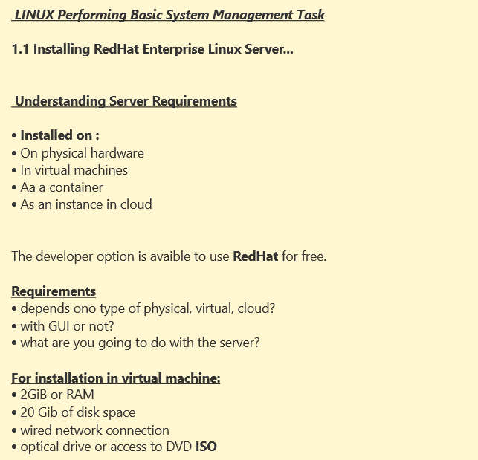

Slide 4
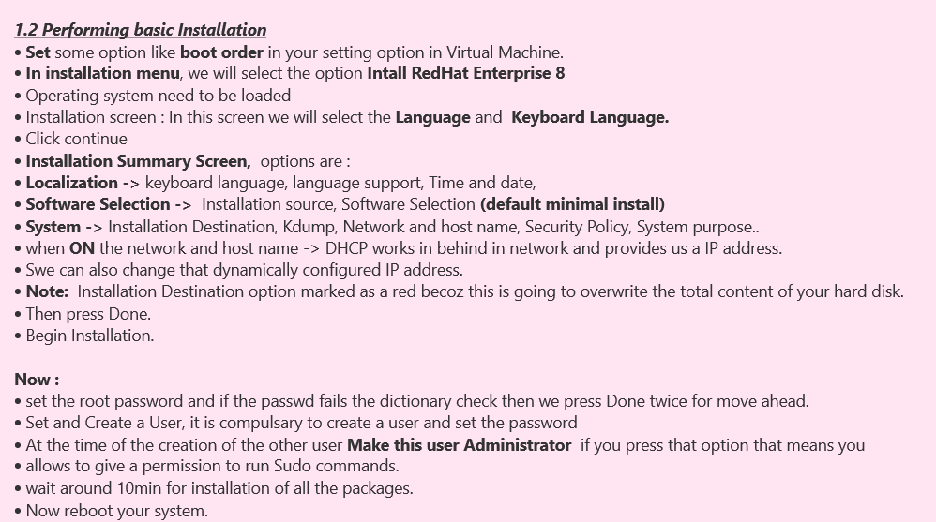

Slide 5
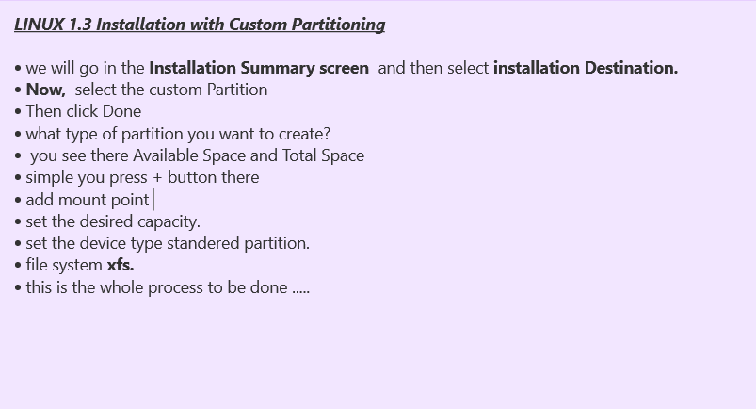

Slide 6
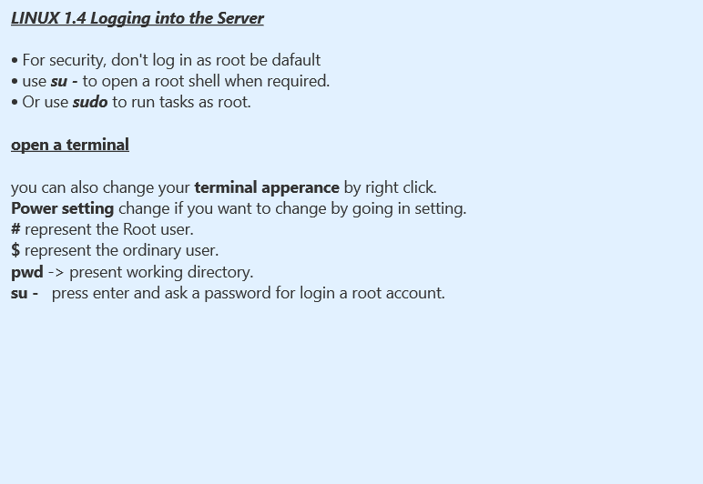



Slide 7
